Slide 1
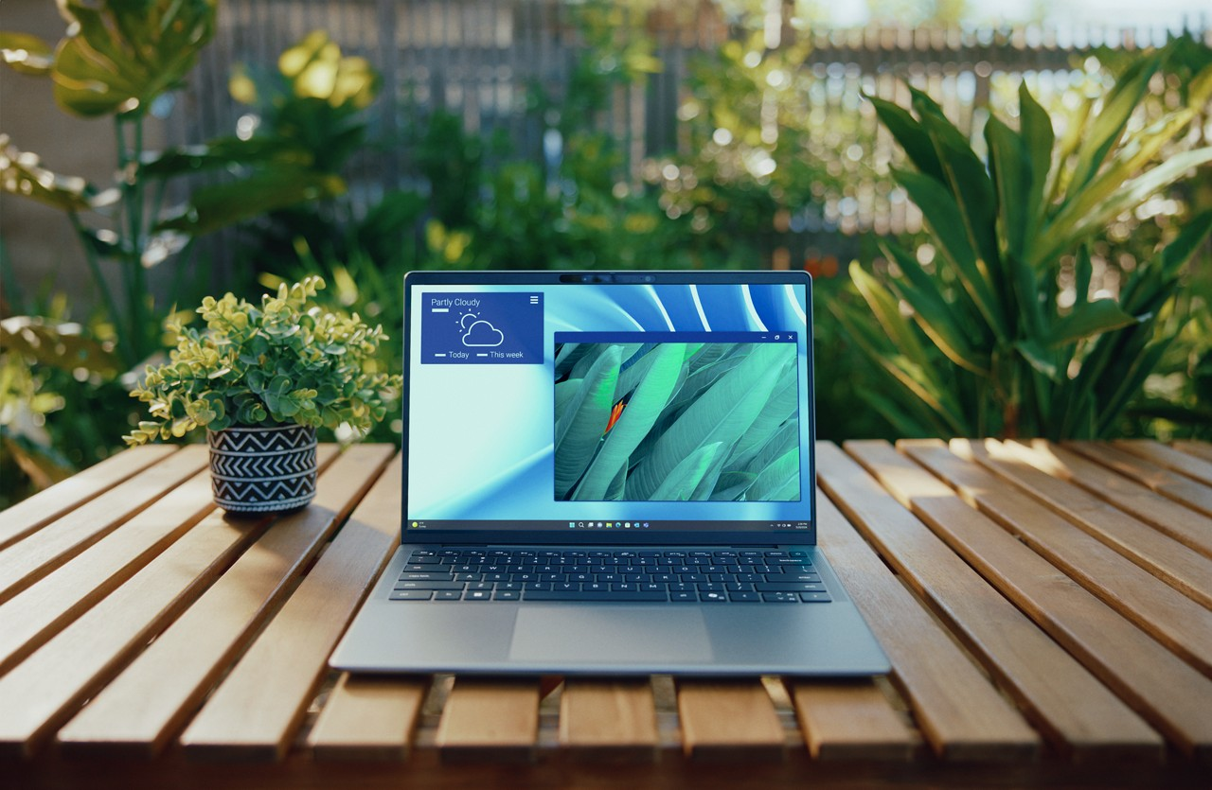
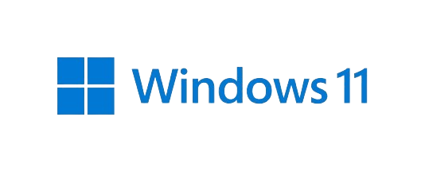

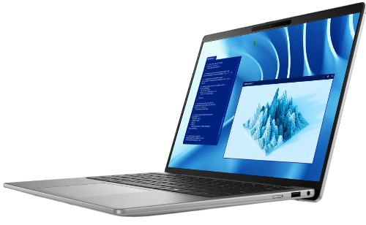
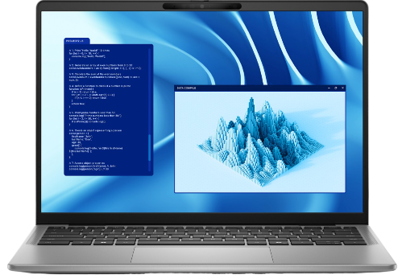

Empower Your Workflow:
Unleashing the Potential of the
Copyright © Dell Inc. All Rights Reserved.
Notes:
Enhanced Productivity: Learn how Copilot+ PCs streamline workflows, empowering your team to achieve more with cutting-edge technology.
Real-World Applications: Hear success stories and practical use cases that demonstrate the power of Copilot+ PCs in action.
Advanced Security: See how these systems are built to protect your data and keep your organization secure.

Slide 2

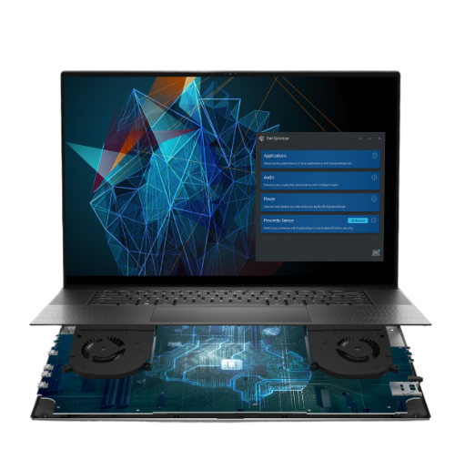
Dell Trusted Workspace
Built-on Software Security, Built-in Hardware & Firmware Security, & Built-with Supply Chain Security
Multiple Layers of Defense
Built-in Security
Supply Chain Security
Advanced Threat Detection
Copyright © Dell Inc. All Rights Reserved.
Notes:
When the world went hybrid, enterprise needs for security changed. With hybrid workforce there is no longer the safety net of on-prem enterprise-level security. AI has also opened up new opportunities and challenges.
As one of the largest PC and Infrastructure solution providers, Dell is in a unique position to help secure our customer environments.
That’s because we know IT, and we know security.
Our endpoint security portfolio Dell Trusted Workspace offers both the hardware and software security customers need to combat modern cyberattacks.
Our first priority is to get customers out AHEAD of the attackers.
- Then, in zero trust fashion, we always plan for the worst-case scenario: a breach.
So instead of focusing on blocking every attack, Dell commercial PCs offer unique visibility and tamper detection down to the deepest levels of the device.
- These built-in features are what make Dell the world’s most secure commercial PCs – and that’s validated by third-party research.
We also know that no one solution can do it alone.
Security is a team sport. And we believe customers should have optionality to meet the unique needs of their organizations.
To that end, in addition to the foundational built-in security of Dell commercial PCs (Lati, Opti, Precision), we also offer leading partner solutions to further bolster customer security.
- Later today, Nate is going to walk you through the features Microsoft offers to further secure your workspace and improve security across your fleet…

Slide 3

What’s the difference between a
CPU, GPU, and NPU?
CPU
Central Processing Unit
GPU
Graphics Processing Unit
NPU
Neural Processing Unit
Element of System on Chip (SoC)
TOPS
Trillions of Operations Per Second
Brain of the computer
Performs basic operations from software instructions, loaded from memory
Specialized to render 2D and 3D objects
Can perform operations in parallel, processing vectors of data simultaneously
Specific architecture for deep learning
Integrated as an element of the SoC
Hardwired matrix without need for memory access
Trained specifics, Inference operations
A measure of the total maximum achievable throughput for an NPU.
Copyright © Dell Inc. All Rights Reserved.
Notes:
Neural Processing Unit is an Element of System on Chip (SoC) and has a specific architecture for deep learning, integrated as an element of the SoC and this make the consumption of AI in the future even faster and less dependent to the cloud.- That’s the key here- no internet connect required.
A measure of the total maximum achievable throughput for an NPU is TOPS (Trillions of Operations Per Second)
TOPS stands for Trillion Operations Per Second¹. It is a metric used to measure the overall performance of a supercomputer or a high-end circuit board containing multiple processors or SOCs (system-on-chips)¹. The term is often used to evaluate the computing capabilities of AI chips².
TOPS provides a simplified measure of how many computing operations an AI chip can handle in one second².
It quantifies the number of basic math problems a chip can solve within that short period of time². While TOPS does not differentiate between the types or quality of operations a chip can process, it can be used to compare the relative performance of different AI chips².
It’s important to note that TOPS is an abstract measure of capability and does not provide a complete picture of an AI chip’s performance. Other factors such as memory, throughput, and inference efficiency also play significant roles in determining overall performance³.

Slide 4
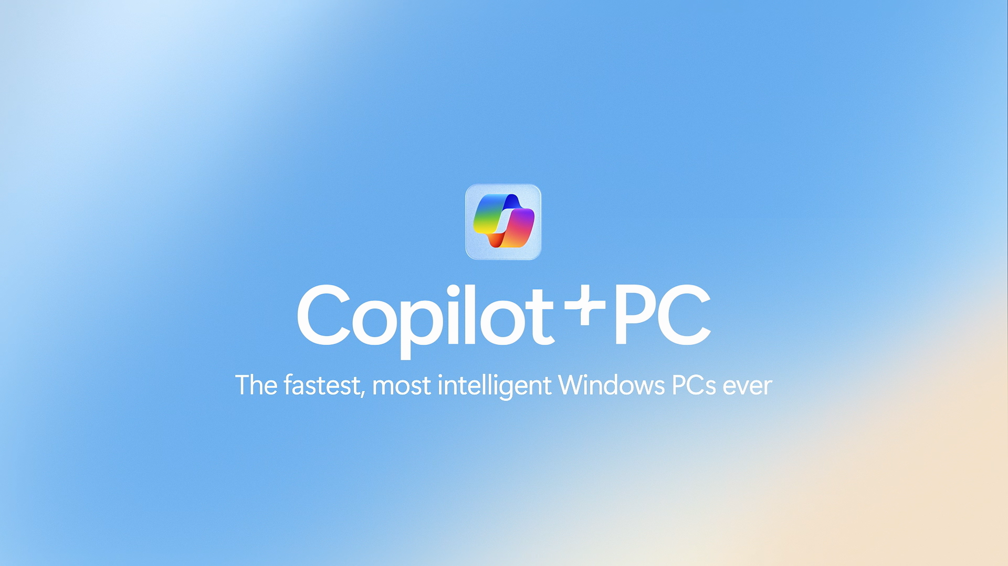
Copilot+ PCs
A new AI era of PCs
With 45 TOPs NPUs to power new AI experiences and incredible performance.
Copyright © Dell Inc. All Rights Reserved.
Notes:
1m 25s video - marketing video on Copilot+ PCs – music background
Dell Latitude Copilot+ PCs are a game-changer. Powered by Snapdragon NPUs, they're powerful and can handle tough workloads, with hardware-backed AI and security innovations that enable new efficiencies and help safeguard your mission-critical data.
This new category of devices come with AI built-in and optimize by an NPU, and they’re also Secured-Core PCs that come with the Microsoft Pluton security processor for the highest level of Windows security.
These PCs can help you find important info faster, get projects done quicker, and help keep your data safe. All so you can innovate, solve problems, and make a bigger impact in your business.

Slide 5
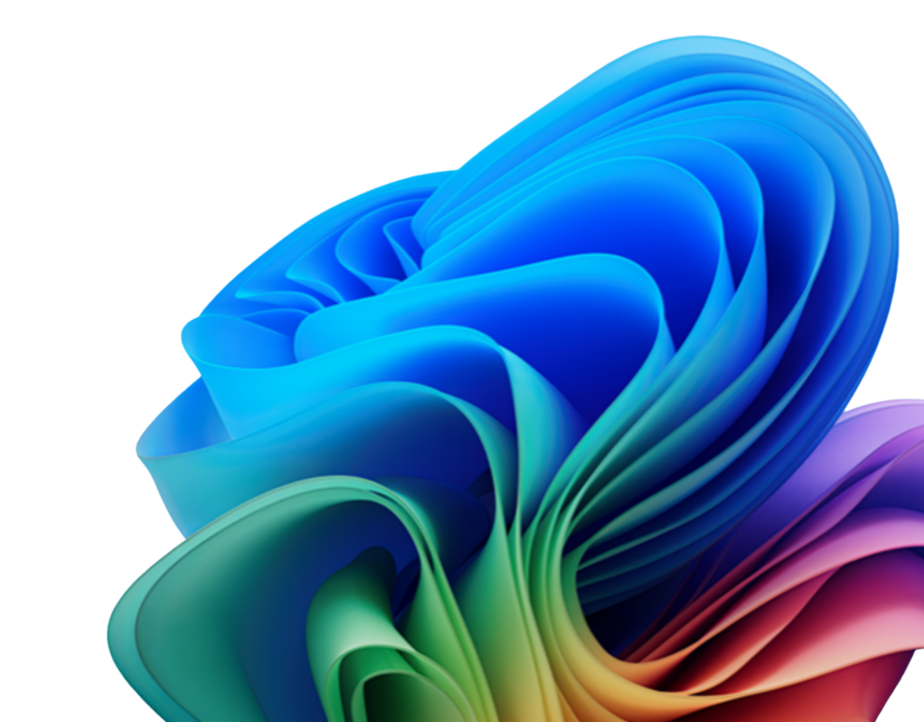
Target Customers: Early Adopters
In non-regulated industries that have a higher percentage of employees in sales and marketing functions
Early adopter
ITDM
Under pressure to ensure an ambitious Al strategy delivers returns but wary of the tech challenges and security risks
Early adopter
ITDM
Betting on Al as a key growth driver and investing in their best people to turn technology into improved business outcomes
Early adopter
SMB Founder/Owner
Seeing affordable Al solutions as a game-changing source
of productivity gains and improvements in
customer service
Early adopter
Sales & Marketing Pros
Making Al-powered technologies the tools of the trade for an agile, creative and data-informed sales and marketing team
Copyright © Dell Inc. All Rights Reserved.
Notes:
ITDM’s: Under pressure to ensure an ambitious AI strategy delivers returns while remaining cautious of technological challenges and security risks, and ITDMs who are investing in AI as a primary growth driver and empowering top talent to leverage technology for enhanced business outcomes.
SMB Founder/Owner: Who recognize affordable AI solutions as a transformative driver of productivity enhancements and customer service improvements
Sales & Marketing Pros: Transforming AI-powered technologies into essential tools for a nimble, innovative, and data-driven sales and marketing team.
Example: XPS 9345 averaged 19 hours and 41 mins of battery life, which beat the HP OmniBook, Lenovo Yoga Slim, and the Samsung Galaxy Book.

Slide 6
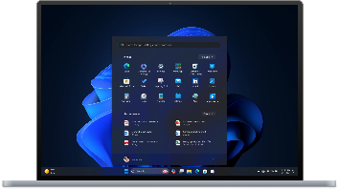
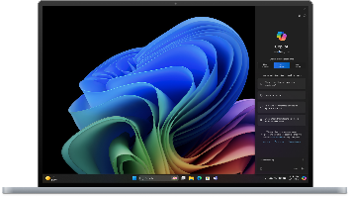
Win Pro PC vs. Copilot+ PC
 | Windows 11 Pro PCs | Copilot+ PCs
 | Accelerate business success | The fastest, most intelligent Windows PC ever
Copilot | Copilot in Windows | Copilot in Windows, plus unique AI experiences
Hardware & performance | CPU and GPU | CPU, GPU, and NPU for faster performance overall and richer AI
Search | Microsoft Search, File Explorer, Copilot¹ | Microsoft Search, File Explorer, Copilot, Recall²
Security | Default protection in Windows 11 Pro | Secured-core PC protection and Microsoft Pluton
Video conferencing | Smart videoconferencing | Windows Studio Effects
Live Captions | Live Captions (language to language)⁴ | Live Captions with real-time translation³ (40+ languages)
AI ready | Supports existing AI features and functionality | Ready for next wave of AI innovation
Notes:
Windows innovation includes Windows 11 Pro devices that you might already own, and a new category of devices called Copilot+ PCs.
It’s important to understand that all new Windows devices offer incredible value with a core set features and capabilities. Those include Copilot in Windows, intelligent suggestions, snap layouts, layers of security out-of-the-box, and compatibility with your existing apps and hardware. And of course they’re all easy to use, deploy, and manage.
Windows 11 Pro devices accelerate business success, and if you a look at a few of the features included here you’ll see why. They’re significantly faster than Windows 10 devices, they’re more secure, and they have a host of great features for productivity.
If you’re ready for a big leap forward, Copilot+ PCs usher in a new era in computing. These devices include a built-in NPU, which is designed to accelerate AI and data processing. And by off loading take key AI processes to the NPU, the CPU and GPU can also run faster and more efficiently. Here are some additional benefits you get with this new category of device.
In addition to Copilot and intelligent suggestions, you also get Recall. Powered by the NPU, Recall can search across your timeline history, apps, documents, and conversations to deliver relevant results, and suggest next steps you can take.
Secured-core PC protection and Microsoft Pluton provide the highest level of security for Windows PCs.
Windows Studio Effects is also powered by the NPU, giving you more refined videoconferencing experience without dragging down your battery.
Live Captions is also powered by the NPU, giving you not just Live Captions, but the ability to translate 40+ languages into English in real time.
This is just the beginning. If you get a Copilot+ PC now, you’ll be ready for the next wave of AI innovation, including more apps that leverage the data and AI processing power of the NPU.
1 Copilot with commercial data protection is available at no additional cost for users with an Entra ID and an enabled, eligible Microsoft 365 or Office 365 license. Copilot in Windows (in preview) is available in select global markets and will roll out starting in summer 2024 to Windows 11 PCs in the European Economic Area.. 2 Optimized for select languages (English, Chinese (simplified), French, German, Japanese, and Spanish). Content-based and storage limitations apply. Learn more. 3 Currently supports translation for video and audio subtitles into English from 40+ languages. Learn more. 4 Supports English, Chinese, French, German, Italian, Japanese, Korean, Portuguese, Spanish, and Danish

Slide 7
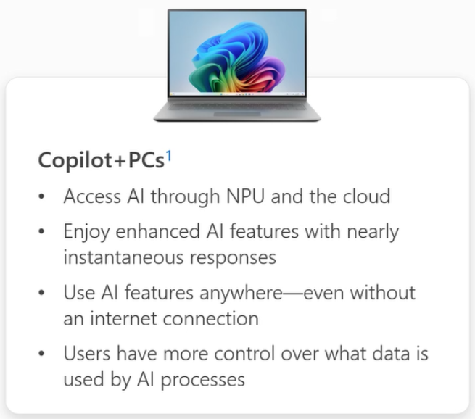
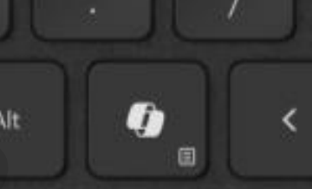
Copilot+ PCs
Dell‘s Copilot+ Devices:
  Latitude 5455 (available 9/24)
  Latitude 7455
  XPS 9345
  Inspiron 7441
Local Copilot
Studio Effects +
Instantly Recall
Quickly get information from your local machine to help you get engaged faster with local Copilot capabilities
Enhanced features for Studio Effects. High Resolutions, Live Translations, etc.
Quickly get back up and running where you
left off with your past work
Discover & Do
Interact Naturally
Seamless Integration
Ability for your PC to learn how you work and provide you with insights and optimizations
Use audio and or the keyboard to interact naturally with the PC
AI seamlessly integrated into Windows. Launch other Copilot applications from anywhere within Windows
PC Requirements
Hardware: | 40+ TOPs NPU | 256 GB SSD | 16 GB Memory
OS: | Windows 11 24H2
Dell Offers: | QC (Harmoa / Purwa) | Intel (LNL) | AMD (STRIX)
Cost: | No additional cost for Copilot + PC | (M365 Subscription only)
New Copilot Key will launch Copilot when
present
Copyright © Dell Inc. All Rights Reserved.
Notes:
Dell’s first Copilot+ PC powered by Snapdragon® X Series is Latitude 7455.
Bringing increased productivity and allows for more time for innovating thanks to advanced AI capabilities. This is game-changing performance with groundbreaking battery life.
Co-Pilot+ PCs are systems equipped with a local version of Co-Pilot allowing them to operate independently of an internet connection. This is ideal for end users that travel frequently for work because the AI features will still work while on airplane mode.
Window’s 11 Pro PCs will require an internet connect to access the new Co-Pilot features native to the Co-Pilot+ PCs.

Slide 8
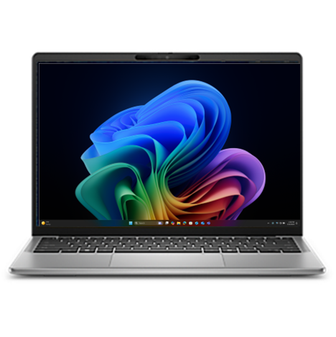
Copilot+ PCs
Copilot+ PC features & capabilities
Powerful performance for transformative impact
Unlock productivity superpowers
Powerful security
designed for AI
Turbocharge your
business impact
Accelerate success with turbocharged NPU, for an unmatched experience with lightning speed, smooth performance ​and richer AI.
With unique AI experiences, you can uncover new opportunities, solve problems faster, and create compelling content.
Safeguards your most sensitive information with Secured-core PC protection.
Puts AI and performance at your service, so your team can respond to business needs with speed and agility.
40+ TOPs (trillion operations per second)
Long battery life¹
Energy-efficient performance
Copilot key²
Recall^{3 (in beta)}
Windows Studio Effects
Live captions⁴
Microsoft Pluton security processor
Windows Hello Enhanced Sign-in Security
Hardware-backed MDM enrollment
Enhanced phishing protection with Microsoft Defender Smartscreen
Protected Print Mode
Copilot in Windows for self-service setup of accessories.
Manage with existing tools and policies
Ready for modern device management
Reduced energy consumption
Tailor for unique business needs with expanded Copilot experiences including Microsoft Copilot Studio,⁵ Copilot for Microsoft 365,⁶ and Copilot for Security.⁶
Copyright © Dell Inc. All Rights Reserved.
Notes:
Copilot+ PCs deliver the performance and rich AI experiences to help unlock productivity and light up innovation. They all come with layers of out-of-the-box default protection, plus the Microsoft Pluton security processor for Secured-core PC protection. That’s the highest level of security you can get with a Windows PC.
These PCs easy to deploy and manage like any Windows 11 device.
Listed here are some of the rich set of features and capabilities that deliver the performance, productivity, security and business-readiness of Copilot+ PCs.
Microsoft Defender SmartScreen is a security feature integrated into Windows and Microsoft Edge. It helps protect your device by blocking potentially malicious websites, downloads, and applications. Here are some key points about it:
Protection Against Threats: SmartScreen uses reputation-based protection to warn you about potentially harmful sites and files¹.
Phishing and Malware Defense: It helps block phishing and malware attacks while you browse the web².
Customizable Settings: You can enable or disable SmartScreen through Windows Security settings, Microsoft Edge settings, Internet Properties, Registry Editor, and Group Policy Editor¹.
Recall- A feature that watches everything you do and allows you to search through your history using natural language prompts
GPT-4o- this will be built into Windows and allow you to go much further with the AI portion. Think of voice mode in Scarlett Johanson’s voice plus the ability to understand your voice and have conversations
Small Language Models – AI is built on Large Language model, This will allow certain models to be dedicated to specific functions
Copilot Runtime – System Level Code Library the same way Windows 32 was built but with AI
AI Agents – Allows you to build complex workflows and intelligent agents based off of your day to day. Sales emails, respond to customer support requests, and how to improve based on feedback
Co-Creator for MS Paint – allows you to start with specific prompts with AI generated pictures and edits. I actually love this feature- you can even doodle a poor drawing & it will glow it up to make it look professionally done.
Real-Time Filtering – Using the NPU, it allows you to filter your face & eye movement while your camera is on.
Battery life varies based on settings, usage, device and other factors.
When Copilot for Windows is not available or enabled on the device, pressing the Copilot key will launch Windows Search. Learn more.
Optimized for select languages (English, Chinese (simplified), French, German, Japanese, and Spanish). Content-based and storage limitations apply. Learn more.
Currently supports translation for video and audio subtitles into English from 40+ languages. Learn more.
Sold separately. Copilot Studio Preview is available with Microsoft 365 Business Standard, Business Premium or Microsoft 365 E3/E5.
Sold separately. Microsoft 365 Business Standard, Business Premium or Microsoft 365 E3/E5 required.

Slide 9

Copilot+ PCs
Microsoft Pluton
The most advanced Windows security with Microsoft Pluton
Secured-core PCs and Pluton are two distinct, complementary Windows security offerings that can be used together for more comprehensive protection.
Enhanced Windows 11
hardware security
Pluton is a security processor that protects credentials and other sensitive data with hardware root-of-trust directly integrated into the silicon of the CPU.
Pluton can be used as a TPM or with a discrete TPM.
Secured-core PCs are computers with layers of hardware-backed safeguards enabled by default for the highest level of Windows protection across firmware, OS, identities, and data.
Copilot+ PCs are Secured-core PCs that include Pluton for additional protection and flexibility.
Secured-core PC
Pluton
AND
Advanced security
enabled by default
OS hardware
root-of-trust
Copyright © Dell Inc. All Rights Reserved.
Notes:
Shield your most sensitive data with Secured-core PC protection including the Microsoft Pluton security processor and an NPU to enable highly secure and performant AI processes.
Secured-core PCs and Pluton are two distinct, complementary Windows security offerings that can be used together for more comprehensive protection.
Pluton is a security processor that is embedded into the silicon of a CPU. (Chip-to-cloud OS security strategy)
Microsoft Pluton is designed by Microsoft and built by silicon partners, MFST Pluton in a secure cypto-processor built into the COU for security at the core to ensure code integrity and the latest protection with updates delivered by Microsoft through Windows update. Pluton protects credentials, identities, personal data and encryption keys. Information is significantly harder to be removed even if an attacker has installed malware or has complete physical possession of the PC.
- Secured-core PCs are defined as computers that provide the highest level of Windows protection across firmware, the OS, hardware, identities, and data by default. Secured-core PCs were initially designed for people in data-sensitive roles and industries, and now the same level of protection is available to everyone with Copilot+ PCs.
Note that TPM 2.0 is a requirement for every new Windows 11 device, including Copilot+ PCs.
Microsoft Pluton and TPM (Trusted Platform Module) 2.0 are both security technologies, but they differ in several ways and can be used separately or together.
Integration: TPM is a separate hardware component used to securely store sensitive information on Windows PCs, while Pluton is built directly into the CPU.
Functionality: Microsoft Pluton provides the functionality of the Trusted Platform Module (TPM), establishing the silicon root of trust. It supports the TPM 2.0 industry standard, allowing organizations to benefit from enhanced security in Windows features that rely on TPM, including BitLocker, Windows Hello, and Windows Defender System Guard.
Security: Credentials, encryption keys, and other sensitive information can’t be easily extracted from Pluton, even if an attacker installs malware or has complete physical possession of the device. Storing sensitive data like encryption keys securely within the Pluton processor, which is isolated from the rest of the system, helps ensure that emerging attack techniques such as speculative execution can’t access key material
Updates: Pluton solves the major security challenge of keeping its own root-of-trust firmware up to date across the entire PC ecosystem, by delivering firmware updates from Windows Update. This is different from TPM firmware, which gets updates from various sources.
Usage: Microsoft Pluton can be used as a TPM, or in conjunction with a TPM3. Although Pluton builds security directly into the CPU, device manufacturers may choose to use a discrete TPM as the default TPM, while having Pluton available to the system as a security processor for use cases beyond the TPM.

Slide 10
Copilot+ PCs
Copilot+ PC unique features
Unique AI experiences to elevate your search, productivity, creativity and communication.
Features and capabilities
This is just the beginning. Look forward to continuous innovation of new features delivered to your Copilot+ PC
​
Recall¹
  With just a few words for context, find almost anything you’ve seen on your desktop
Live captions with translation (English expanded)²
  Instantly translate any live or recorded video in any app or video platform
Windows Studio Effects Creative filters​
      Portrait lighting​
      Quick Settings
      Voice focus enhanced​
      Portrait blur
      Eye contact enhanced​
Secure-core PC protection for highest level of Windows security by default plus Microsoft Pluton
Cocreator
Allows you to tell Paint what kind of art you want to make, and then fine-tune how much Paint applies that request to the artwork you create
Optimized for select languages (English, Chinese (simplified), French, German, Japanese, and Spanish). Content-based and storage limitations apply. Learn more.
Currently supports translation for video and audio subtitles into English from 40+ languages. Learn more.
Copyright © Dell Inc. All Rights Reserved.
Notes:
Copilot+ PCs include unique AI features experiences to elevate your search, productivity, creativity and communication.

Slide 11
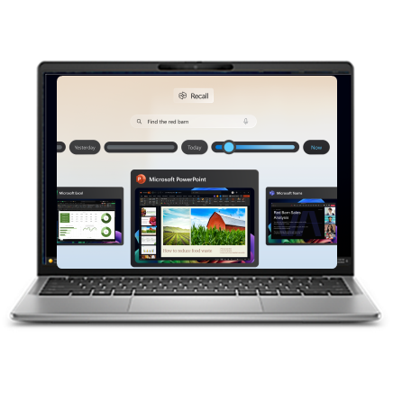

Copilot+ PCs
Recall
Describe it to find it. With just a few words for context, find almost anything seen on your device. (“Find the daily sales data shared
by Mandy)”
Recall¹ can be accessed in multiple ways, including your taskbar.
Personalized and contextual. Searches across your timeline, apps, documents, communications, and services to find and
predict the most relevant content.
1 Optimized for select languages (English, Chinese (simplified), French, German, Japanese, and Spanish). Content-based and storage limitations apply.
Copyright © Dell Inc. All Rights Reserved.
Notes:
17s video cut on recall – music background and image simulation.
Recall is unique to Latitude 7455 and 5455 Copilot+PCs. It’s powered by the NPU, and unlike any search feature you’ve used before in Windows.
With just a few words for context, find almost anything you’ve seen on your device. You can just describe something in your own words and Recall will search snapshots of your activity across your timeline, apps, documents, communications, and services to find the most relevant content.
When you find the right content with Recall, you can take the next step in your workflow by relaunching the original website or document from a snapshot. Then you can do things like start an email, open text or an image in another app, and more.
Content-based and storage limitations do apply.
Recall:
When available it sits in your system tray and basically works like an expanded search function for your PC, but it can search not just through data on your PC but also the history of what you've done on it. So if you were to search for an image of a boat or a webpage about boats you were looking at last week, you could type "boat" and Recall will show you a scrollable timeline of everything you've looked at onscreen over the past month or so that includes images of boats or the word boat.
That's a very simple explanation of what appears to be a complex new system which captures "snapshots" of what you're doing on your Windows PC at regular intervals, then stores, scans and indexes those screenshots for semantic search.

Slide 12

Copilot+ PCs
Live Captions
Live Caption translations allow you to stay connected and never miss a conversation.
Instantly translate¹ your video calls or any recorded video in any app or video platform into English subtitles, in real time.
1 Supports translation for video and audio subtitles from 44 languages into English.
Copyright © Dell Inc. All Rights Reserved.
Notes:
13s video cut on live captions – music background and image simulation.

Slide 13
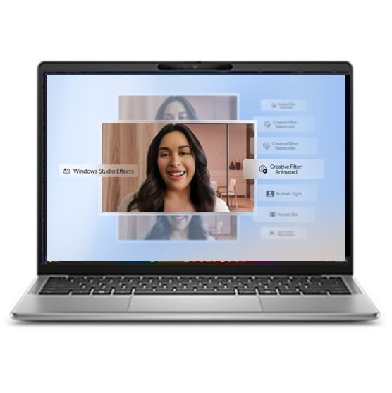
Copilot+ PCs
Windows Studio Effects
Enable engaging teamwork with flattering portrait lighting, natural-looking eye contact and more, powered by the NPU and Windows Studio Effects
Creative filters
Activate three different artistic filters in any video platform and access them in Quick settings:
Illustrated | Animated | Watercolor
Portrait blur
Automatically adjust the lighting in video calls, in any app or video platform, to brighten yourself against the background.
Voice focus
Enhanced voice focus removes background noise for maximum clarity on video or audio calls.
Portrait blur
Apply a light blur so you’re always in focus.
Eye contact
Maintain eye contact even when you’re reading content on the screen.
Copyright © Dell Inc. All Rights Reserved.
Notes:
Have more effective meetings anywhere. With Windows Studio Effects, you can put your best face forward in videocalls with flattering portrait lighting, creative filters, natural eye contact and more easily accessible in Quick Settings

Slide 14
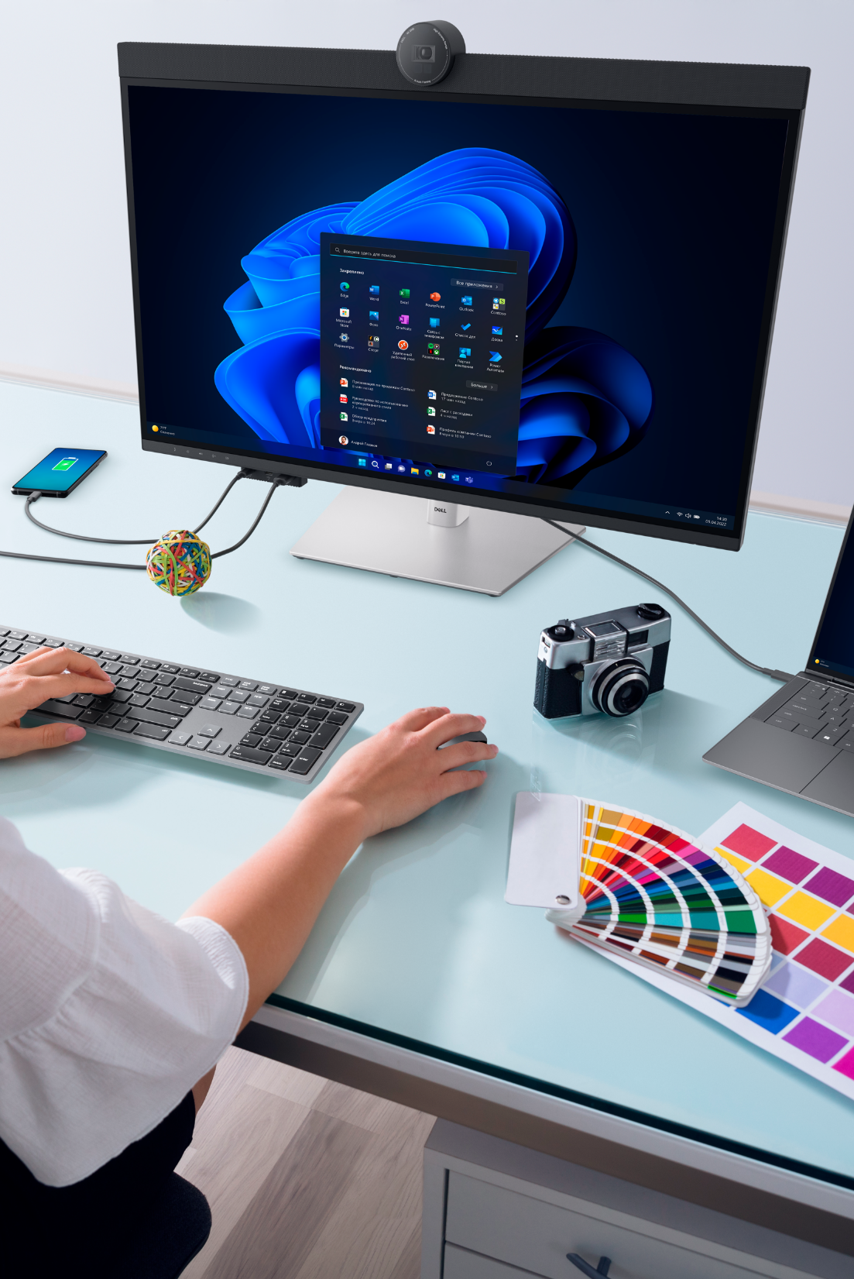




Better together solutions with Dell & Windows 11
Boost productivity
Drive AI-level productivity and faster business outcomes with the world’s most intelligent business PCs¹ and Windows 11.
Trusted Security
Protect with the industry’s most secure commercial PCs² and the most secure Windows ever.
Fast, zero-touch device management
Enable IT teams to provision and control end-user devices faster and easier.
Proven industry leaders working together – Dell & Microsoft
Drive the modern workforce outcomes you need with the services and support of two partners working together for over 35 years.
Copyright © Dell Inc. All Rights Reserved.
Notes:
We've talked about Windows 11, and now looking at our solution, with Dell and Windows 11, it really is Better Together, a partnership of over 35 years.
Boost productivity and collaboration
Begin your AI journey with Dell PCs and Windows 11 to unlock AI-level productivity that drives meaningful work by automating day-to-day operational tasks through intelligent devices. Dell has the world’s most intelligent business PCs¹ with Dell Optimizer – built-in, AI based optimization software that learns and responds to the way you work.
Trusted Security
We’ve shown the security that comes embedded with Windows 11 on Dell devices. With Dell you also have:
- Hardware-based security: Dell Devices keep users protected from the inevitable attack with unmatched “built-in” security at the BIOS/firmware and hardware levels (e.g., Dell SafeBIOS).
- Software-based security: Dell offers “built-on” software solutions to improve the security of any fleet, delivered by an ecosystem of fully vetted, best-of-breed partners.
Security solutions for businesses and organizations that require more robust security measures and you have it covered with the industry’s most secure commercial PCs² and the most secure Windows ever.
Fast, zero-touch modern device management
Dell and Microsoft make life easier for IT teams with fast, zero-touch device management. Teams can customize, provision, and control end-user devices—faster and with less effort—with Dell Connected Provisioning + Windows Autopilot. Dell Command + Endpoint Configure for Intune remotely automate and configure BIOS settings to fit IT teams’ needs. Finally, Microsoft App Assure reduces migration complexity by ensuring that 99.6% of applications are compatible with Windows 11.³
Dell & Microsoft partnership
Over 35 years of partnership to help you achieve your goals through a suite of offerings and services. Dell holds all 7 Microsoft solution competencies, we are one of the largest global fast track partners and we are a member of the Microsoft Intelligent Security Association, and our technicians hold more than 47,0000 Microsoft certifications.
Our services can support with planning and migration to deployment, with tools to suit all sizes of companies, whatever stage of the windows transition you are in.
¹Based on Dell analysis, November 2023. Dell Optimizer not available in OptiPlex 3000 series, Latitude Chromebook Enterprise, and Linux-based devices. Feature availability and functionality may vary by model
²Based on Dell internal analysis, September 2023. Applicable to PCs on Intel processors. Not all features available with all PCs. Additional purchase required for some features.
³Microsoft App Assure program data from Oct 2018-Feb 2022.

Slide 15
Thank you!
Inquire away, or simply harvest our wisdom nuggets!
Copyright © Dell Inc. All Rights Reserved.

Slide 16
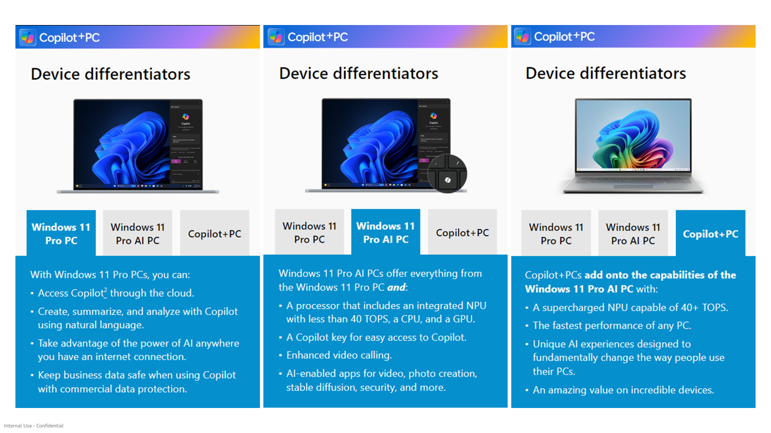

Slide 17
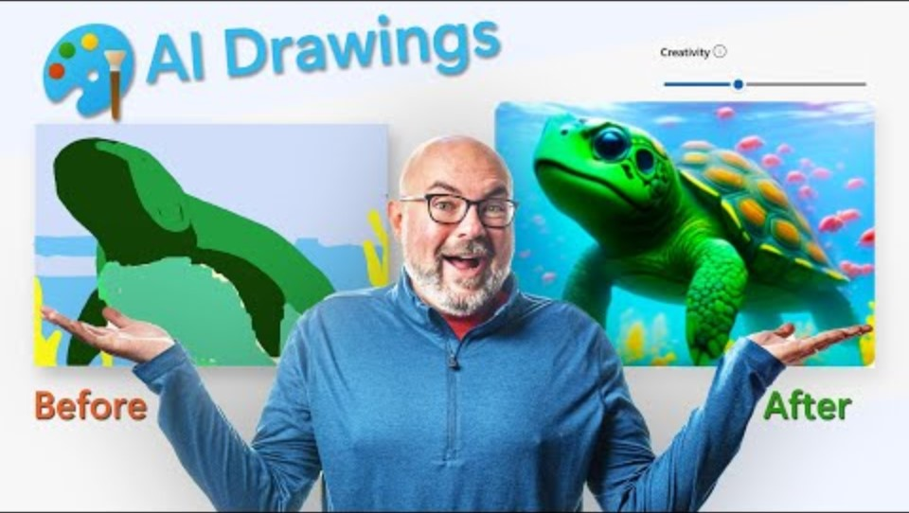
Cocreator

